Slide 1


Week at a Glance for Social Studies
August 22-26

Slide 2
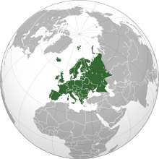
SS6G7 Locate selected features of Europe.
a. Locate on a world and regional political-physical map: the Danube River, Rhine River, English Channel, Mediterranean Sea, European Plain, the Alps, Pyrenees, Ural Mountains, and Iberian Peninsula.
b. Locate on a world and regional political-physical map the countries of France, Germany, Italy, Russia, Spain, Ukraine, and United Kingdom.
SS6G8 Explain environmental issues in Europe.
a. Explain the causes and effects of acid rain in Germany.
b. Explain the causes and effects of air pollution in the United Kingdom.
c. Explain the causes and effects of the nuclear disaster in Chernobyl, Ukraine.
SS6G10 Describe selected cultural characteristics of Europe.
a. Describe the diversity of languages spoken within Europe.
b. Identify the major religions in Europe: Judaism, Christianity, and Islam.

Slide 3
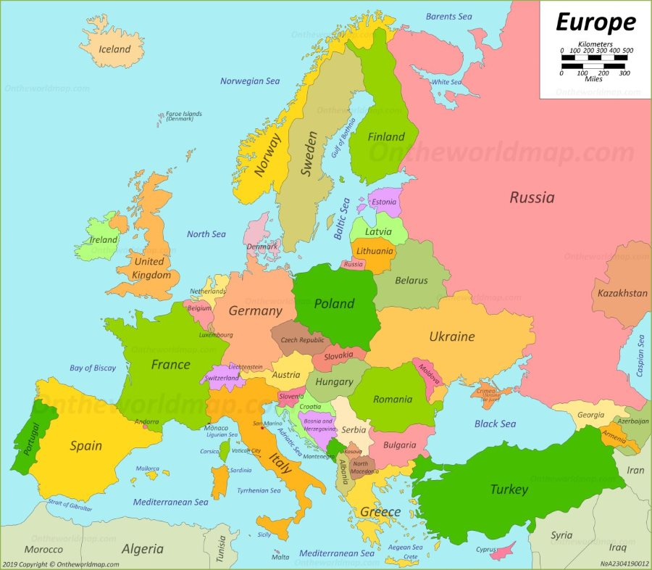
locate on a world and regional political-physical map the countries of France, Germany, Italy, Russia, Spain, Ukraine, and United Kingdom.

Slide 4
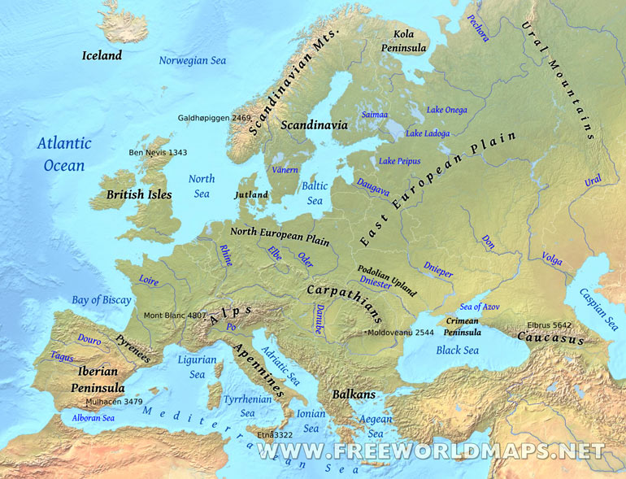
Locate on a world and regional political-physical map: the Danube River, Rhine River, English Channel, Mediterranean Sea, European Plain, the Alps, Pyrenees, Ural Mountains, and Iberian Peninsula.

Slide 5
Monday, August 22
Standard: SS6G7 Locate selected features of Europe.
Learning Target: I can locate select features of Europe.
Warm-up: Silent Reading (Scholastic Magazine).
Work Session: Direct Instruction; students will take notes and view maps of Europe; Brain Wrinkle.
Closing: Think-pair- Share
Reminders: Quiz on Friday

Slide 6
Tuesday, August 23
Standard: SS6G7 Locate selected features of Europe.
Learning Target: I can locate select features of Europe.
Warm-up: Silent Reading (Scholastic Magazine).
Work Session: Students will work on Study Guide with partner; Board Game; Video; Brain Wrinkles
Closing: Teacher Summary
Reminders: Quiz on Friday

Slide 7
Wednesday, August 24
Standard: SS6G7 Locate selected features of Europe.
Learning Target: I can locate select features of Europe.
Warm-up: Color Code Europe Map; Trace each county separately
Work Session: Guided Instruction; students will research each country and physical feature (flip book or graphic organizer); Introduce Environmental Issues and major religion; Brain Wrinkle
Closing: Think-pair- Share
Reminders: Quiz on Friday

Slide 8
Thursday, August 25
Standard: SS6G7 Locate selected features of Europe.
Learning Target: I can locate select features of Europe.
Warm-up: Color Code Europe Map; Trace each county separately
Work Session: Video; Class review of Map Study Guide; Environmental Issues and major religion; Board Game; Brain Wrinkle
Closing: Ticket out the Door
Reminders: Quiz on Friday

Slide 9
Friday, August 26
Standard: SS6G7 Locate selected features of Europe.
Learning Target: I can locate select features of Europe.
Warm-up: Silent Reading (Library Book).
Work Session: Make a Virtual Field Trip for SSG7, G8, G10
Closing: Think-pair- Share
Reminders: Quiz on Friday

Slide 10
Resources for Unit 1: Europe
Countries of Europe
Physical Geography of Europe Part 1- Landforms and Waterways
17 Most Beautiful Countries in Europe – Travel Video

Slide 11
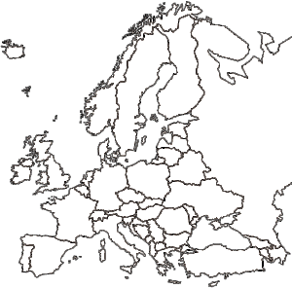

Slide 12
Social Studies Standards
SS6H3 Explain conflict and change in Europe.
a. Describe the aftermath of World War I: the rise of communism, the Treaty of Versailles, the rise of Nazism, and worldwide depression.
SS6G7 Locate selected features of Europe.
a. Locate on a world and regional political-physical map: the Danube River, Rhine River,
English Channel, Mediterranean Sea, European Plain, the Alps, Pyrenees, Ural Mountains,
and Iberian Peninsula.
b. Locate on a world and regional political-physical map the countries of France, Germany,
Italy, Russia, Spain, Ukraine, and United Kingdom.
SS6G8 Explain environmental issues in Europe.
a. Explain the causes and effects of acid rain in Germany.
b. Explain the causes and effects of air pollution in the United Kingdom.
c. Explain the causes and effects of the nuclear disaster in Chernobyl, Ukraine.
SS6G9 Explain the impact of location, climate, natural resources, and population distribution on Europe.
a. Compare how the location, climate, and natural resources of Germany, the United Kingdom and Russia impact trade and affect where people live.
SS6G10 Describe selected cultural characteristics of Europe.
a. Describe the diversity of languages spoken within Europe.
b. Identify the major religions in Europe: Judaism, Christianity, and Islam.
SS6CG3 Compare and contrast various forms of government.
a. Explain citizen participation in autocratic and democratic governments. [i.e., role of citizens in choosing the leaders of the United Kingdom (parliamentary democracy), Germany (parliamentary democracy), and Russia (presidential democracy)].
b. Describe the two predominant forms of democratic governments: parliamentary and presidential.
SS6E7 Analyze different economic systems.
a. Compare how traditional, command, and market economies answer the economic questions of 1-what to produce, 2-how to produce, and 3-for whom to produce.
b. Explain that countries have a mixed economic system located on a continuum between pure market and pure command.
c. Compare the basic types of economic systems found in the United Kingdom, Germany, and Russia.

Slide 13
SS6E8 Analyze the benefits of and barriers to voluntary trade in Europe.
a. Explain how specialization encourages trade between countries.
b. Compare and contrast different types of trade barriers such as tariffs, quotas, and embargoes.
c. Explain why international trade requires a system for exchanging currencies between nations.
d. Describe the purpose of the European Union and the relationship between member nations.
SS6E9 Describe factors that influence economic growth and examine their presence or
absence in the United Kingdom, Germany, and Russia.
a. Evaluate how literacy rates affect the standard of living.
b. Explain the relationship between investment in human capital goods (education and
training) and gross domestic product (GDP per capita).
c. Explain the relationship between investment in capital (factories, machinery, and
technology) and gross domestic product (GDP per capita).
d. Describe the role of natural resources in a country’s economy.
e. Describe the role of entrepreneurship.

